Slide 1
Generation Of Java Beans
Module - 9

Slide 2
Contents
Overview

Slide 3
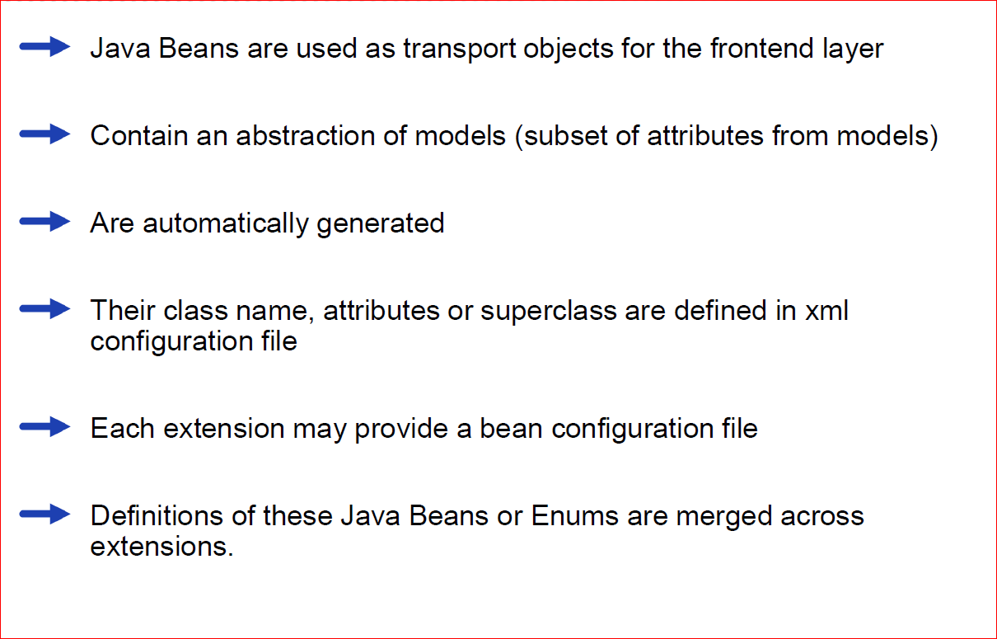
Overview

Slide 4
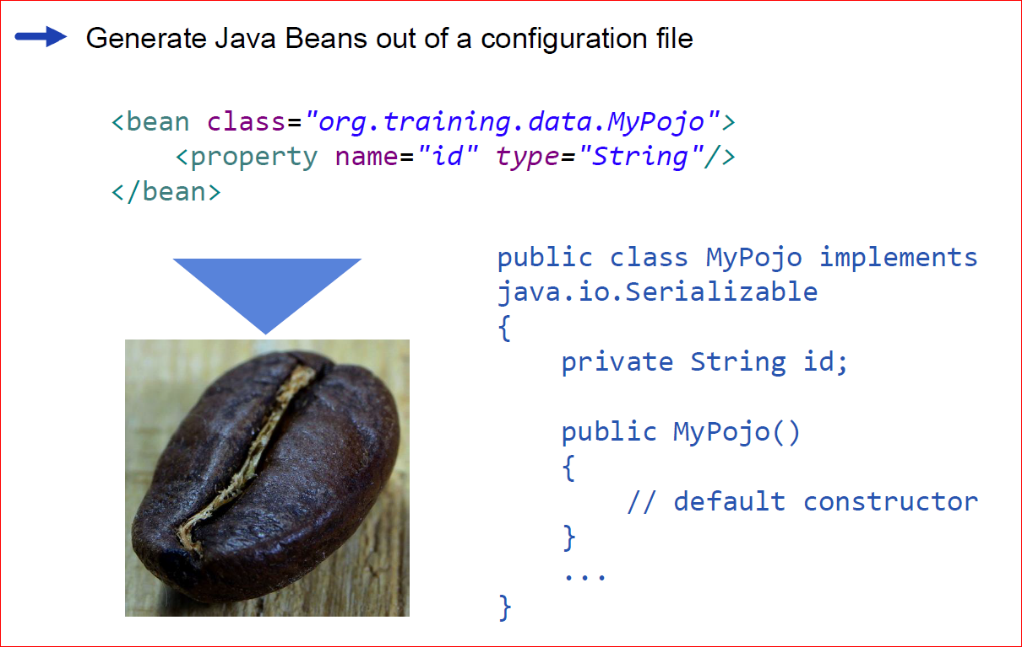
A declarative approach

Slide 5
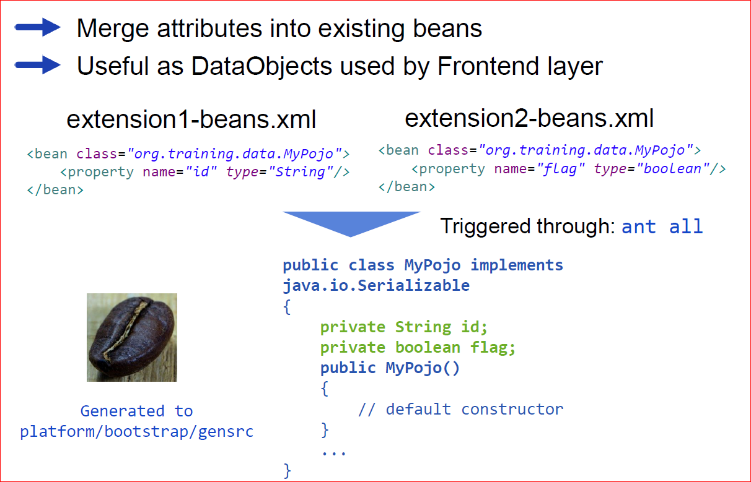
Why?

Slide 6
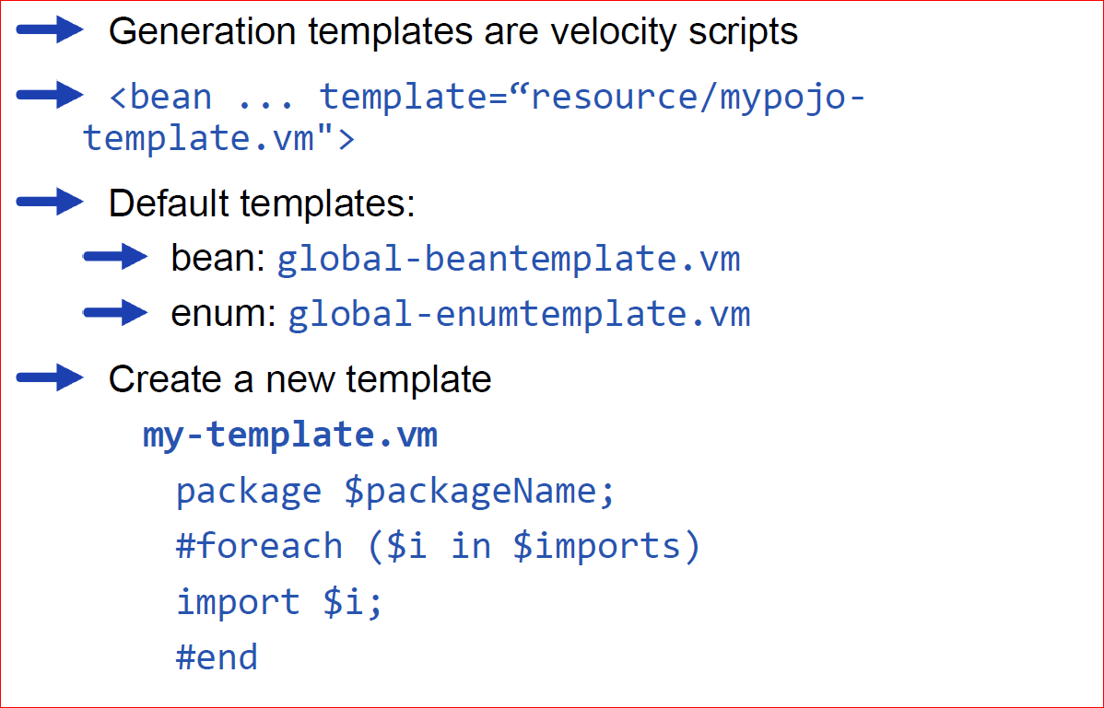
Templates

Slide 7
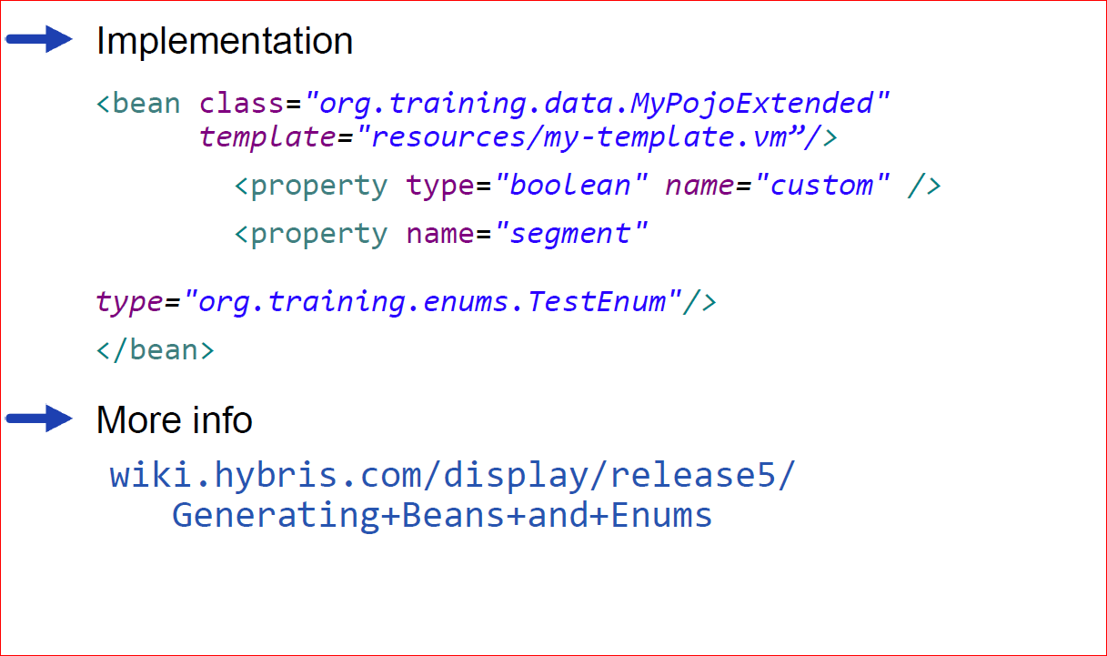
Templates implementation

